Slide 1
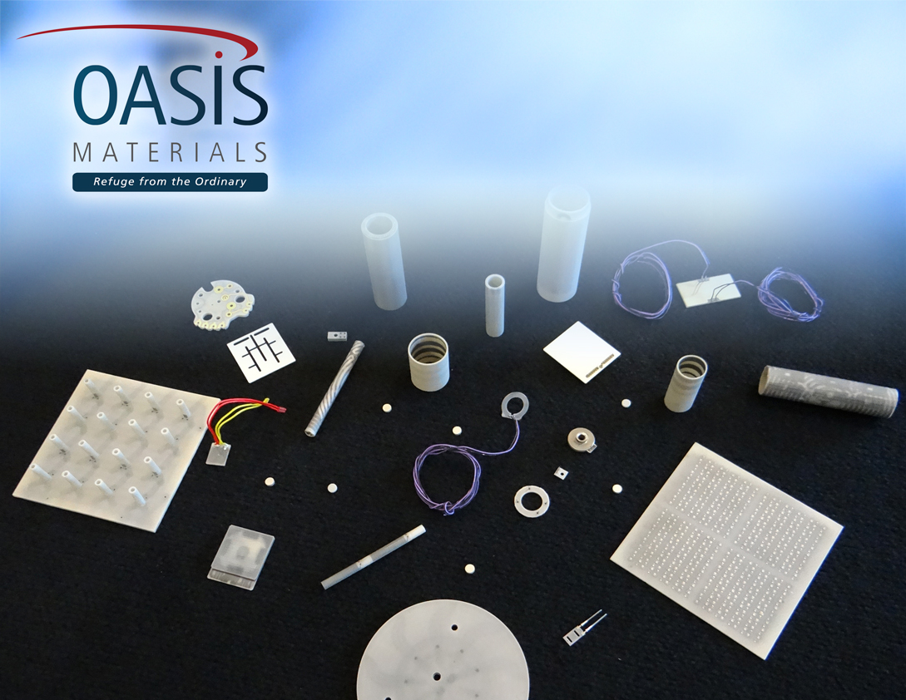
Advanced Ceramic Heater Technologies
Aluminum Nitride (AlN)
Thermal Solutions for Challenging Semiconductor Applications

Slide 2
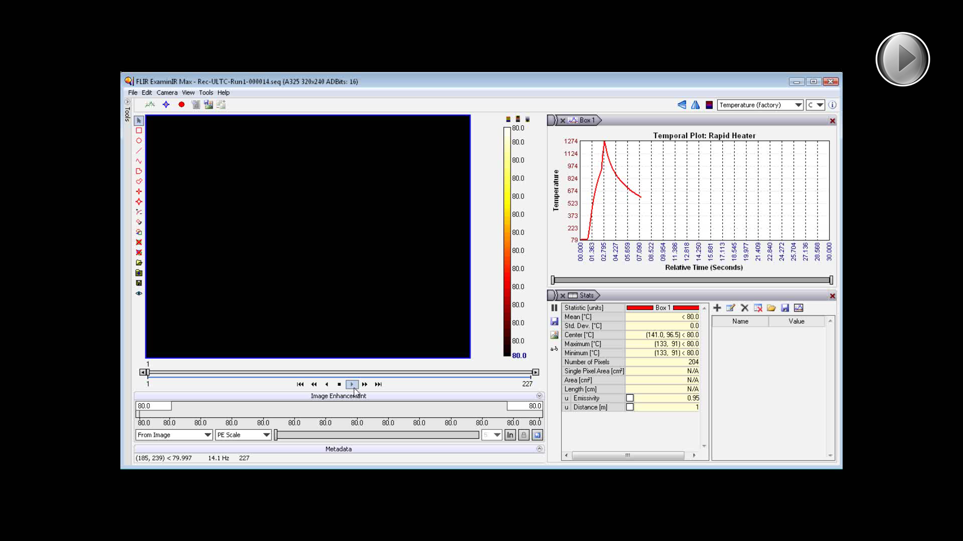

Slide 3
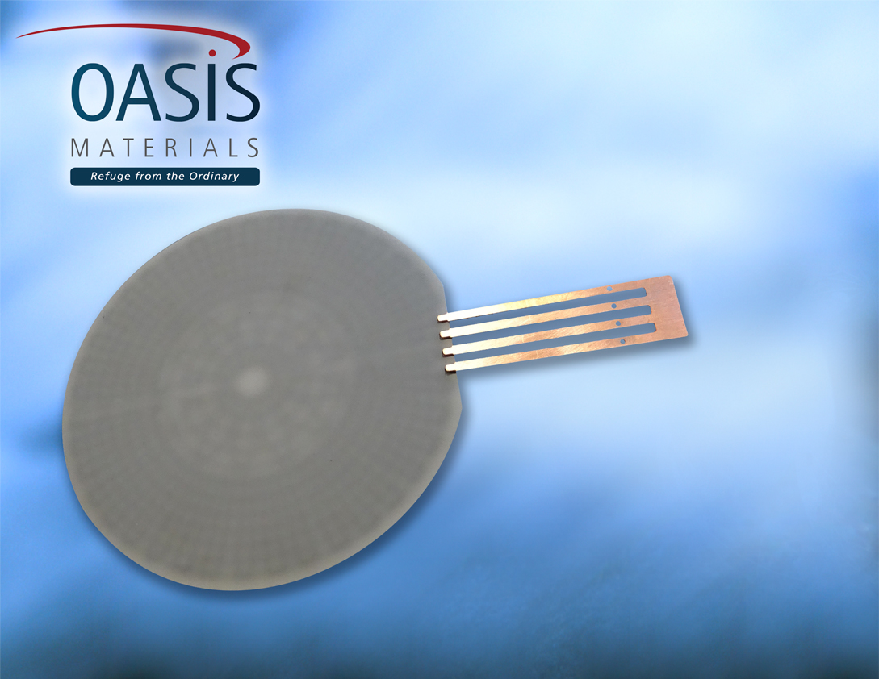
Chemical Vapor Deposition
Plasma Etch • Wafer Test
Multiple Heater Zones for Temperature Uniformity
Integrated Tungsten RTD for Immediate Response to Temperature Change
High Resistance to Chemical Corrosion
Integrated RF Grid

Slide 4
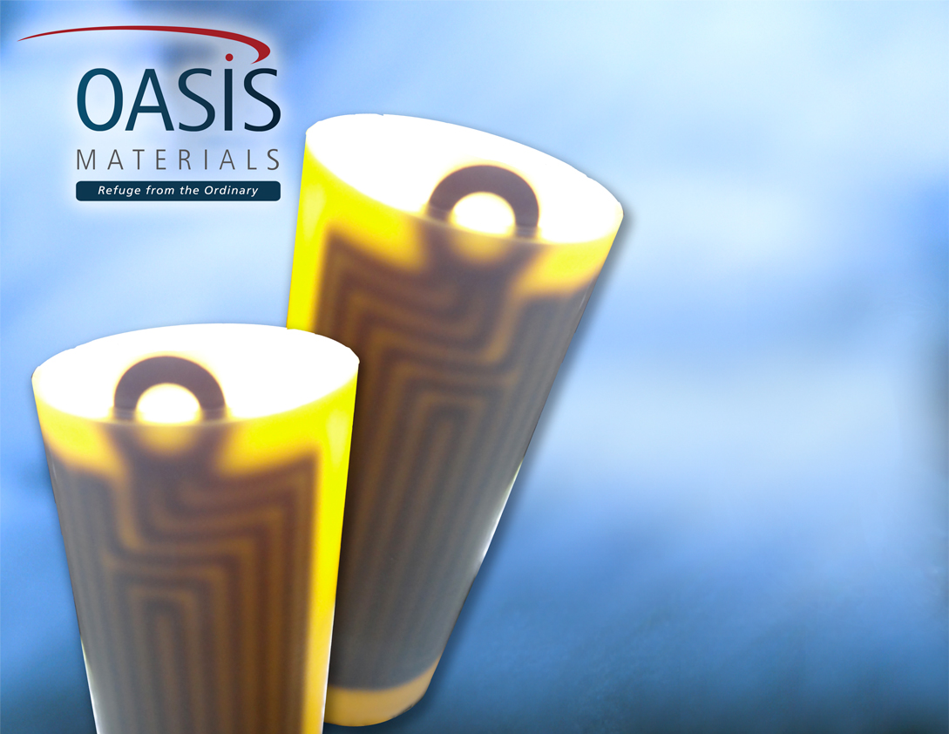
Semiconductor Thermal Solutions
Crucible Heating
Complex 2 dimensional (2D) and 3 dimensional (3D) geometries
High Temperature Applications
Uniform Temperature Profile

Slide 5
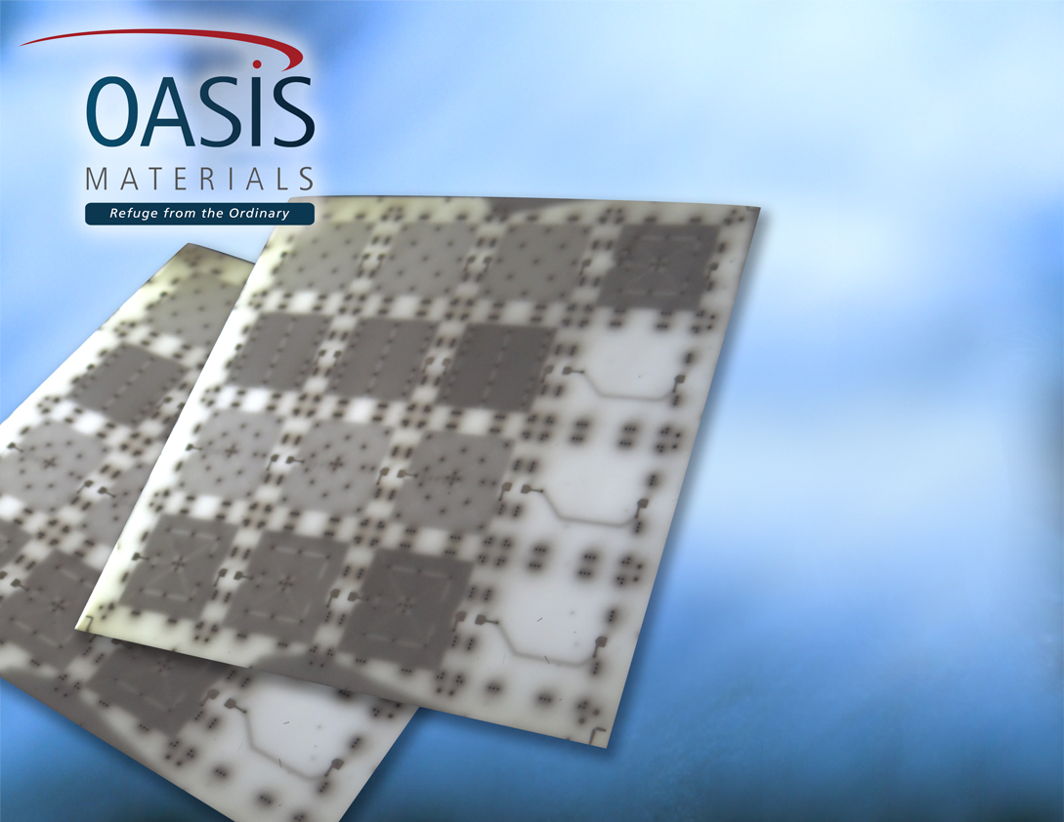
Co-Fired Aluminum Nitride Substrate
Low Coefficient of Thermal Expansion
Homogeneous Construction
Multi-Layer Construction

Slide 6
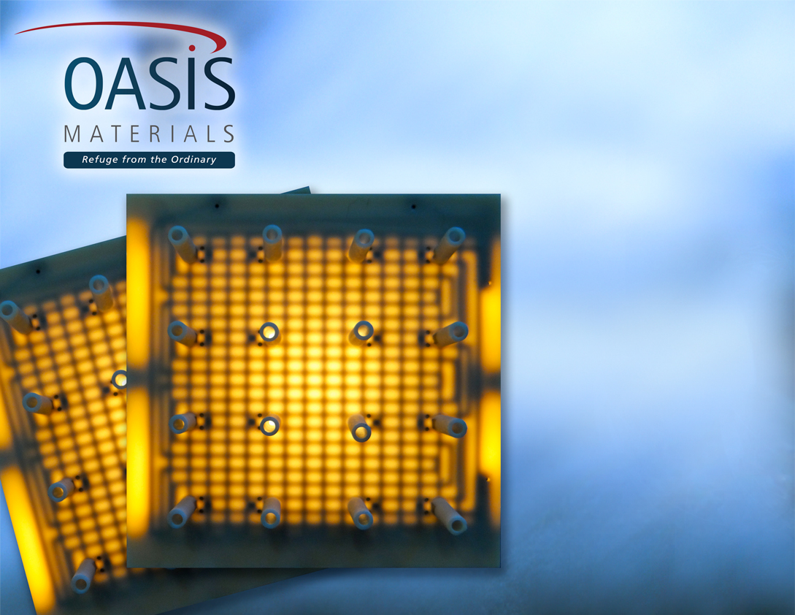
Fluid Dispensing Application
Thermal conductivity: 190 W/mK
High Heat Capacity
Chemical Compatibility

Slide 7
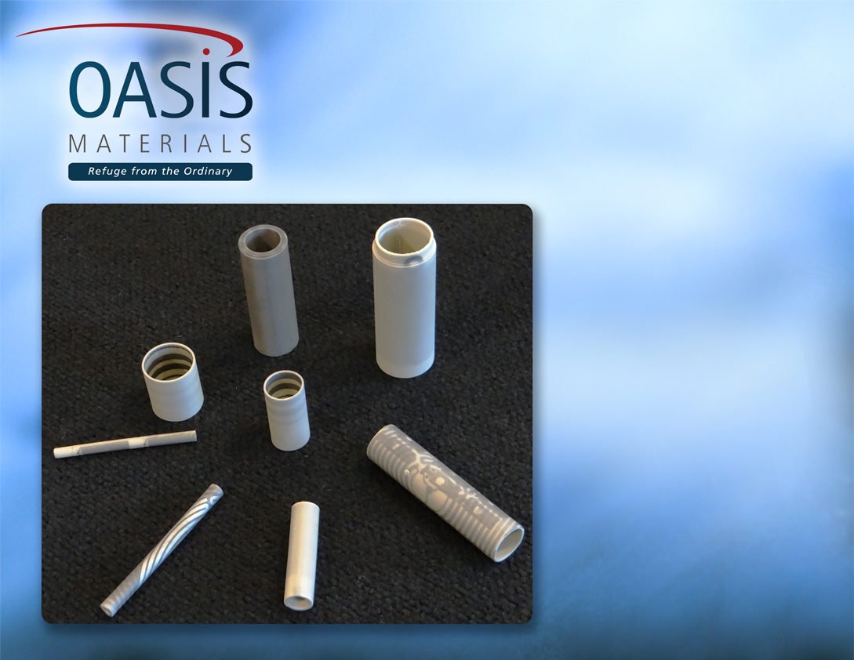
Semiconductor Thermal Solutions
Gas and Fluid Heating
Smooth Non-Porous Surface Finish
Zoned Heater Circuits
High Electrical Dielectric
Chemical Compatibility

Slide 8
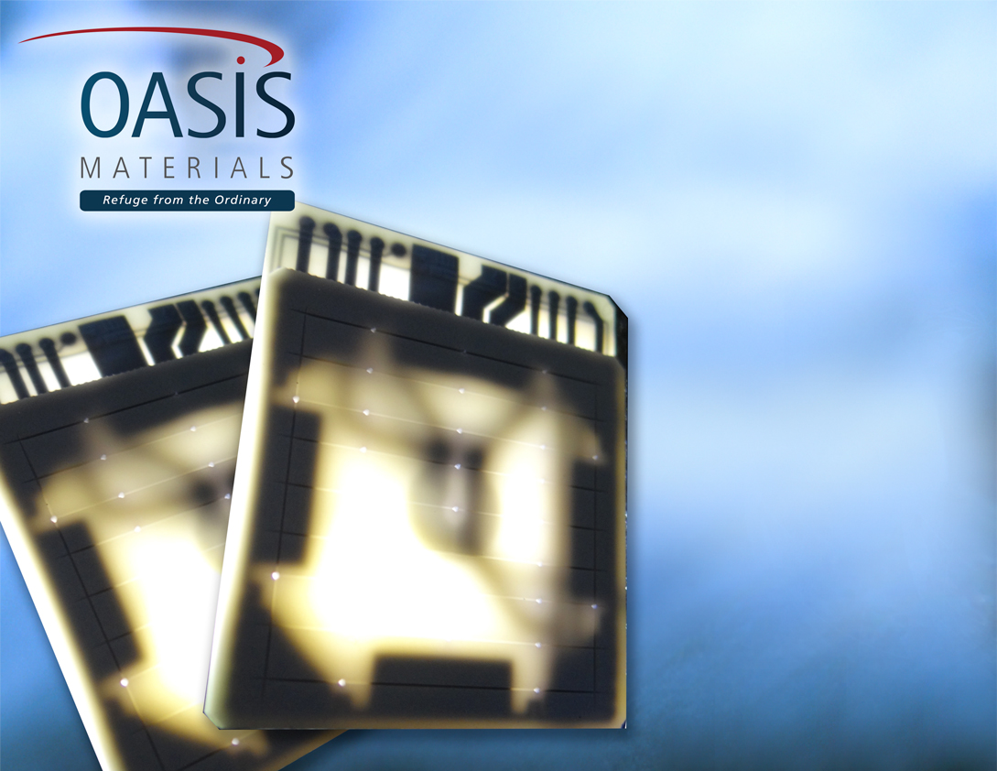
Clinical Diagnostics
PCR Thermal Cycler
Rapid Thermal Cycling
Vacuum Channels
Tungsten Metallization
Distributed Wattage on Edges

